Slide 1
Practice Question on Generation of Grammar from Language CSE322 –FLAT

Slide 2
Ex#1
Generate the grammar for the language
L={an bm | n>=1, m>=0 }
Let the strings will be of type
{ a, ab , aab,abb……………}
It means b can be 0 but a can’t so, accordindly
A->aA | a
B -> bB | Ꜫ
Then S-> A B
so , if we derive the strings from the given production rules
then S->AB
-> a. Ꜫ = a
S-> AB
abB -> ab Ꜫ-> ab
So strings are
{ a,ab,…….}

Slide 3
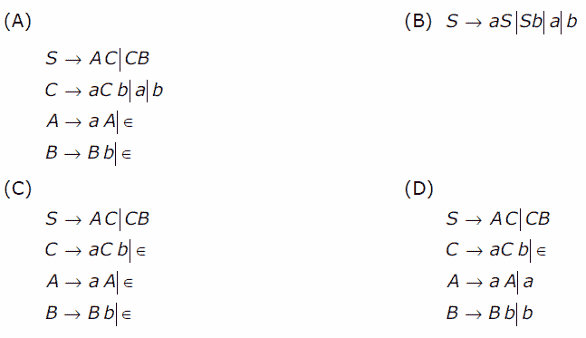
EX#2
Which one of the following grammar generates the language L = {a^{i} b ^{j} | i≠j}

Slide 4
Solution
The given language L contains the strings :
{a, b, aa, bb, aaa, bbb, aab, abb…}It means either the string must contain one or more number of a OR one or more number of b OR a followed by b having unequal number of a and b.
If we consider grammar in option (A), it can generate ab as:
S=>AC=>aA C=>a C=>ab However, ab can’t be generated by language L. Therefore, grammar in option (A) is not correct.
Similarly, grammar in option (B) can generate ab as:
S=>a S=>ab However, ab can’t be generated by language L. Therefore, grammar in option (B) is not correct.
Similarly, grammar in option (C) can generate ab as:
S=>A C=>C=>a C b=>ab However, ab can’t be generated by language L. Therefore, grammar in option (C) is not correct. Therefore, using method of elimination, option (D) is correct.

Slide 5
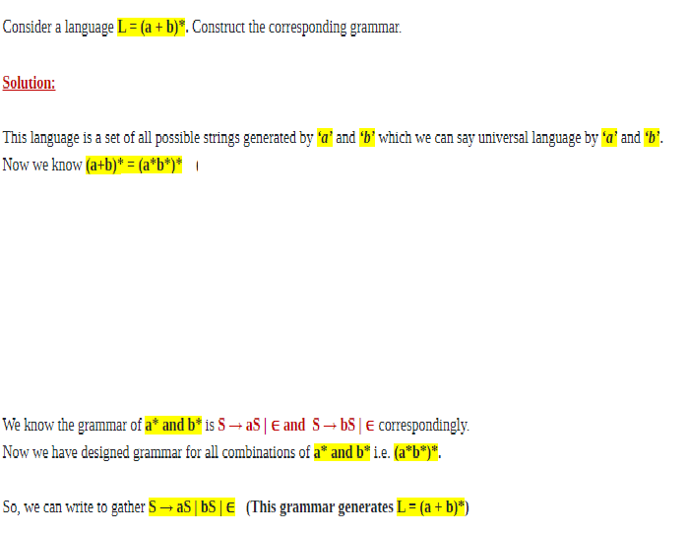
Example # 3

Slide 6
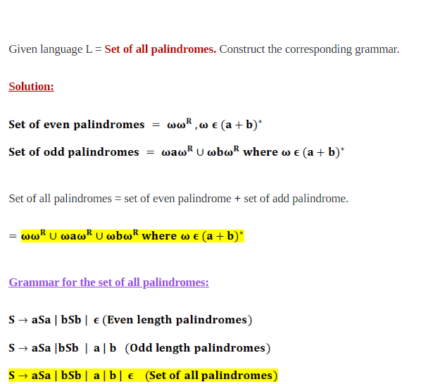
Example #4

